Slide 1
MINI PROJECT
Team No: B1
Roll No:1602-19-737-001
1602-19-737-032
Name: M. Abignya Reddy
Freya Rachel
Class: IT-A

Slide 2
GROCERY MANAGEMENT SYSTEM

Slide 3
Actors wise Use Cases (Features of the project)
User
Register
Login
Search for groceries
Select groceries
View the selected list
View their previous bills
Unregister
Grocery Shop Owner
Track the order details
Update the grocery list
Append the product data
Maintain customer details and bills
View specific bills with customer username or bill number
View total purchases

Slide 4
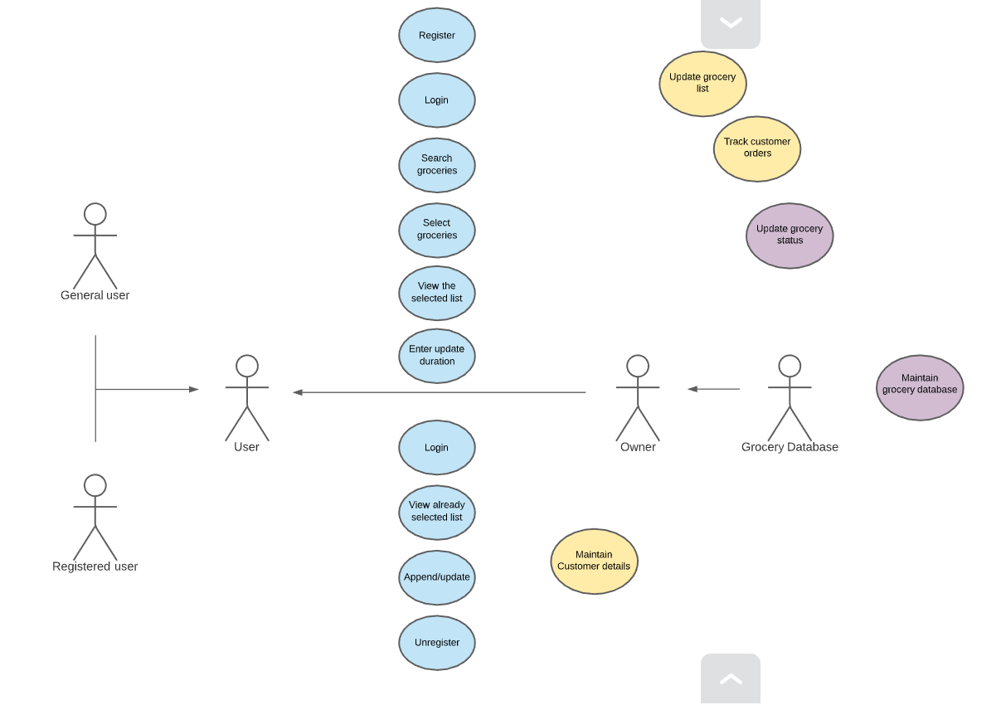
Use Case Diagram:

Slide 5
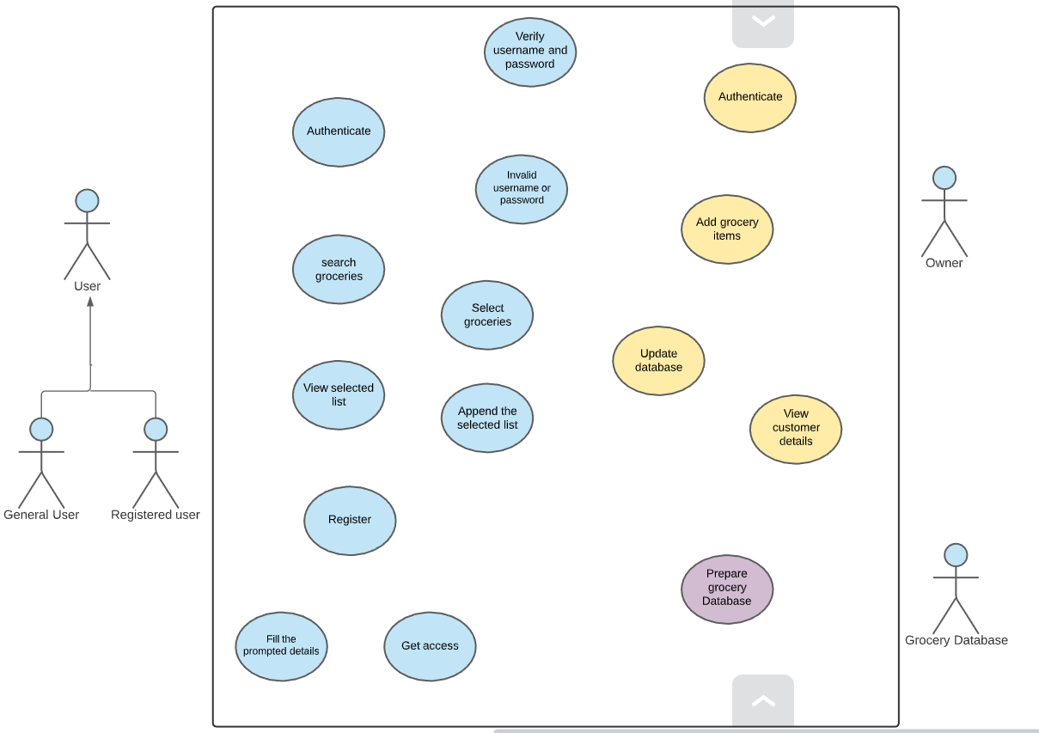
Another Use Case Diagram for reference:
<<exclude>>
<<include>>
<<exclude>>
<<exclude>>
<<include>>
<<include>>
<<exclude>>
<<include>>
<<include>>

Slide 6
Use Case Descriptions
Use Case ID : UC01
Name : Register
Actors : User
Description : Allows new user to register for an account
Pre-condition: None
Post-conditions : An account is created for the new user
Main Flow :
User | System
1. Chooses the sign-up/register option
 | 2. Prompts for data required for registration
3. Enters the data prompted by the system
 | 4. Validates user information. 4.1) If the information is valid, create a new account 4.2) If the information is invalid, display error message and prompt for new values.

Slide 7
Use Case Descriptions
Use Case ID : UC02
Name : Login
Actors : User
Description : Allows registered users to Login
Pre-condition: User should be already registered with the system
Post-conditions : User logs in and all the options are displayed on the screen
Main Flow :
User | System
1. Enters username and password and chooses Login option
 | 2. Validates username and password. 2.1) If the username is invalid, display error message and prompt foe valid username. 2.2) If the password is invalid, display error message and prompt foe valid password. 2.3) If the username and password are valid, then login and display all the details on the screen.

Slide 8
Use Case Descriptions
Use Case ID : UC03
Name : Selection of groceries
Actors : User
Description : Allows the user to select groceries
Pre-condition: The registered user have to Login
Post-conditions : The user will select the groceries and be able to view the final list
Main Flow :
User | System
 | 1. Display all the groceries categories wise
2. Selects a particular category
 | 3. Displays all the groceries in that particular category along with the prices
4. Select required groceries along with the quantity
 | 5. Display the final list with total price along with append option

Slide 9
Use Case Descriptions
Use Case ID : UC04
Name : View previous bills
Actors : User
Description : 1.1) Allows the user to view their previous bills
Pre-condition: The user should have at least one bill
Post-conditions : Previous bills are displayed
Main Flow :
User | System
1. Select the view previous bills option
 | 2. Displays the first bill of the customer
3. Press enter to move to the next bill
 | 4. Displays all bills

Slide 10
Use Case Descriptions
Use Case ID : UC05
Name : Track customer details
Actors : Owner
Description : The owner will be able to track his customers orders and details
Pre-condition: The owner should first enter valid password
Post-conditions : Owner will be able to track the orders and provide service
Main Flow :
Owner | System
1. Enter password
 | 2. Validates password. 2.1) If the password is invalid, display error message and prompt foe valid password. 2.3) If the password are valid, then login and display all the customer details on the screen.

Slide 11
Use Case Descriptions
Use Case ID : UC06
Name : Update/append grocery items and view customer details
Actors : Owner
Description : The owner will be able to update/append his grocery items and view bills
Pre-condition: The owner should first Login
Post-conditions : Grocery items will be updated/appended
Main Flow :
Owner | System
 | 1. Display add product option, customer details option, append product detail option etc.
2. Select any option 2.1) Enter the items you want to add to the current grocery chart. 2.2) Append any product or view bills
 | 3. Display update option
4. Select update option

